Slide 1
Module 2
Quick guide

Slide 2
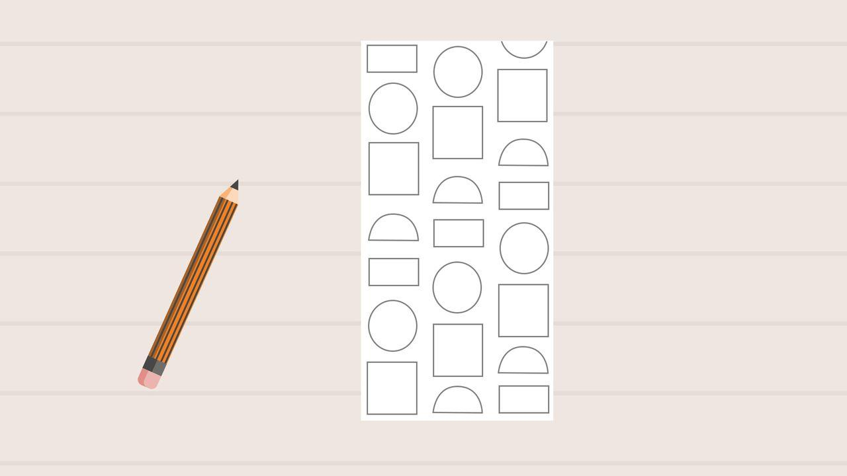
Shape : 02.01 Shape
Page 7
Step One
On your 3x6 piece of paper, use a pencil to create your own pattern. If you forget what a pattern is, just remember that it is a series of shapes that repeat. Your pattern should include at least three geometric shapes and at least two partitioned shapes and should take up most of the space on your paper.
The element of art known as color is also very important to consider when creating the principle of design known as pattern. The colors you use need to repeat, too! Keep this in mind while adding colors to your shapes.
You will need
a 3x6 piece of white paper, either card stock or drawing paper
a pencil
a ruler

Slide 3
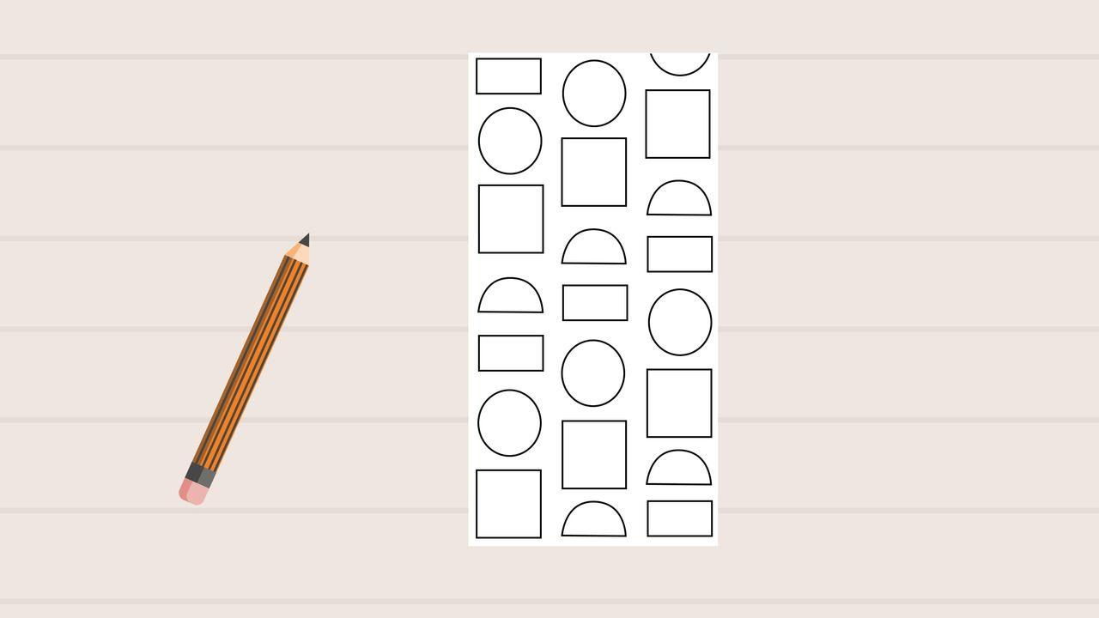
Shape : 02.01 Shape
Page 7
Step Two
Once you've finished sketching your pattern with a pencil, use a thin black marker to outline each of your shapes. This will create the principle of design known as emphasis, and make your shapes stand out.
You will need
a 3x6 piece of white paper, either card stock or drawing paper
a pencil
a ruler

Slide 4
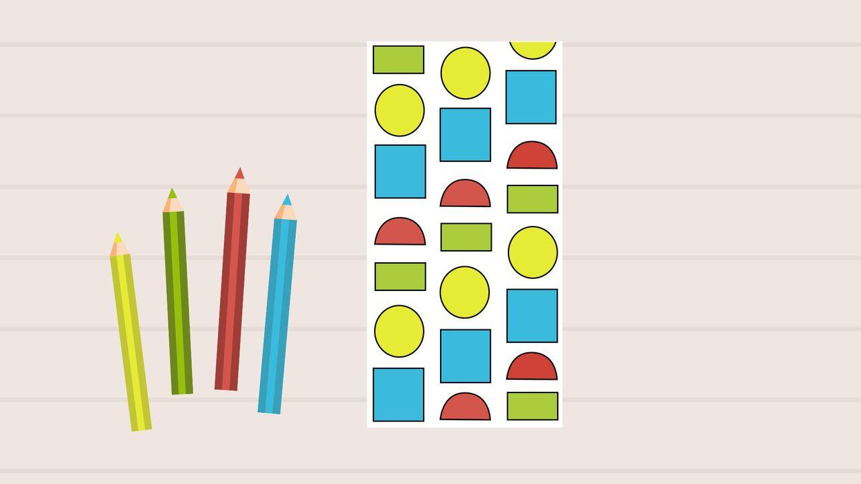
Shape : 02.01 Shape
Page 7
Step Three
After outlining each of your shapes using a thin black marker, add color to your shapes using colored pencils. Use 3–5 different colors of colored pencils to do this.
The element of art known as color is also very important to consider when creating the principle of design known as pattern. The colors you use need to repeat, too! Keep this in mind while adding colors to your shapes.
You will need
a 3x6 piece of white paper, either card stock or drawing paper
a pencil
a ruler
Step Four
Keep your pattern somewhere safe. You will be adding to it later.

Slide 5
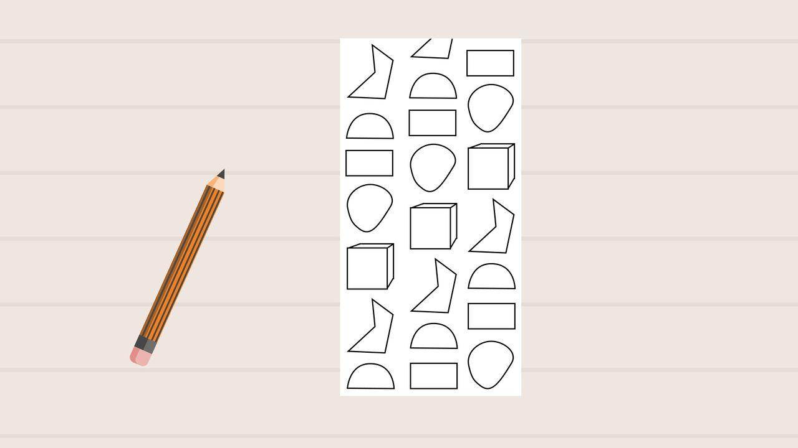
Shape : 02.01 Shape
Page 14
Step One
On your 3x6 piece of paper, use a pencil to create your own pattern, just like you did in Part A Studio Time. This time, your pattern should include the following shapes:
at least two irregular shapes
at least one three-dimensional shape
at least one of the partitioned steps you used to create your pattern in Part A Studio Time.
at least one of the geometric shapes you used to create your pattern in Part A Studio Time.
A few examples of three-dimensional shapes you can use are cubes and pyramids.
You will need
a 3x6 piece of white paper, either card stock or drawing paper
a pencil
a ruler
a thin black marker
colored pencils
optional material—a circle shape to trace

Slide 6

Shape : 02.01 Shape
Page 14
Step Two
Once you've finished sketching your pattern with a pencil, use a thin, black marker to outline each of your shapes. This will create the principle of design known as emphasis, and it will make your shapes stand out.
You will need
a 3x6 piece of white paper, either card stock or drawing paper
a pencil
a ruler
a thin black marker
colored pencils
optional material—a circle shape to trace

Slide 7
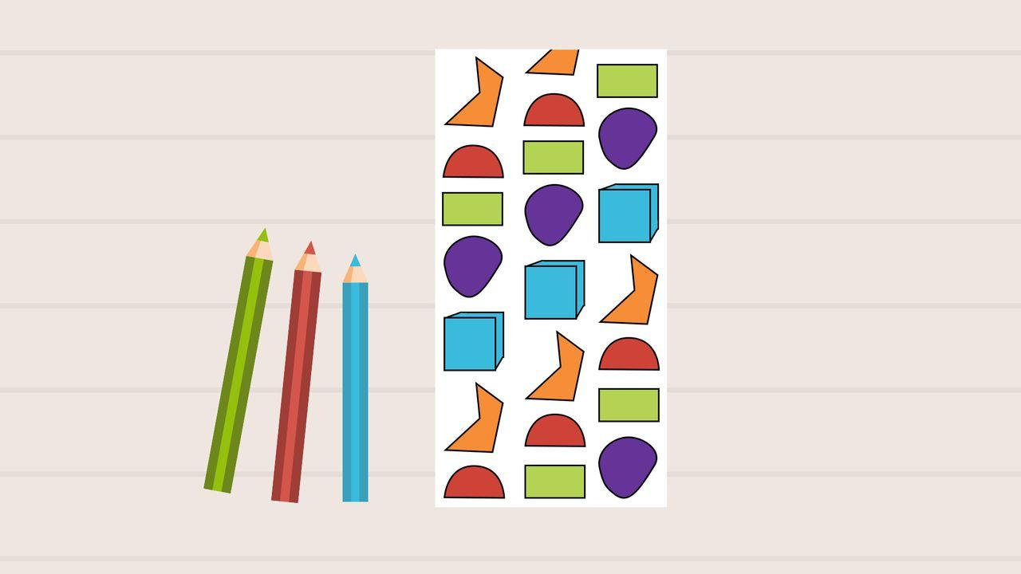
Shape : 02.01 Shape
Page 14
Step Three
After outlining each of your shapes using a thin, black marker, add color to your shapes using colored pencils. Use 3–5 different colors of pencils to do this.
One of the colors you choose to use should be a color you used to complete your pattern in Part A Studio Time.
You will need
a 3x6 piece of white paper, either card stock or drawing paper
a pencil
a ruler
a thin black marker
colored pencils
optional material—a circle shape to trace
Step Four
Keep your pattern somewhere safe. You will be adding to it later.

Slide 8
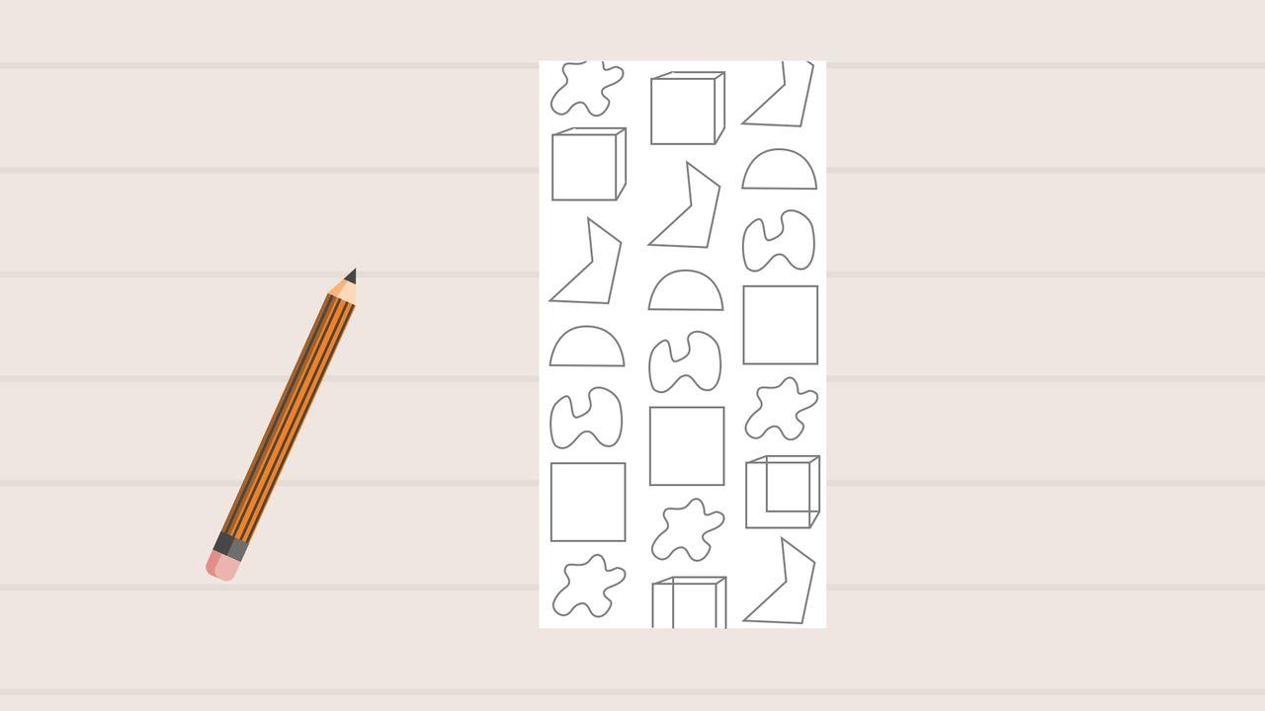
Shape : 02.01 Shape
Page 19
Step One
On your 3x6 piece of paper, use a pencil to create your own pattern, just like you did in Part A and Part B Studio Time. This time, your pattern should include the following shapes:
at least two organic shapes
at least two irregular shapes from Part B Studio Time
at least one three-dimensional shape from Part B Studio Time
at least one partitioned step from Part A Studio Time
at least one geometric shape from Part A Studio Time
You will need
a 3x6 piece of white paper, either card stock or drawing paper
a pencil
a ruler
a thin, black marker
colored pencils
optional material—a circle shape to trace

Slide 9
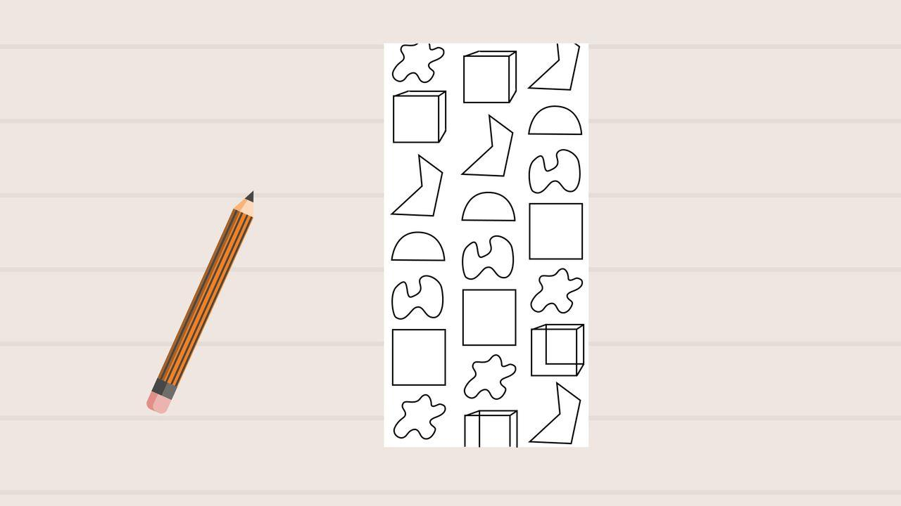
Shape : 02.01 Shape
Page 19
Step Two
Once you've finished sketching your pattern with a pencil, use a thin, black marker to outline each of your shapes. This will create the principle of design known as emphasis. It will also make your shapes stand out.
You will need
a 3x6 piece of white paper, either card stock or drawing paper
a pencil
a ruler
a thin, black marker
colored pencils
optional material—a circle shape to trace

Slide 10
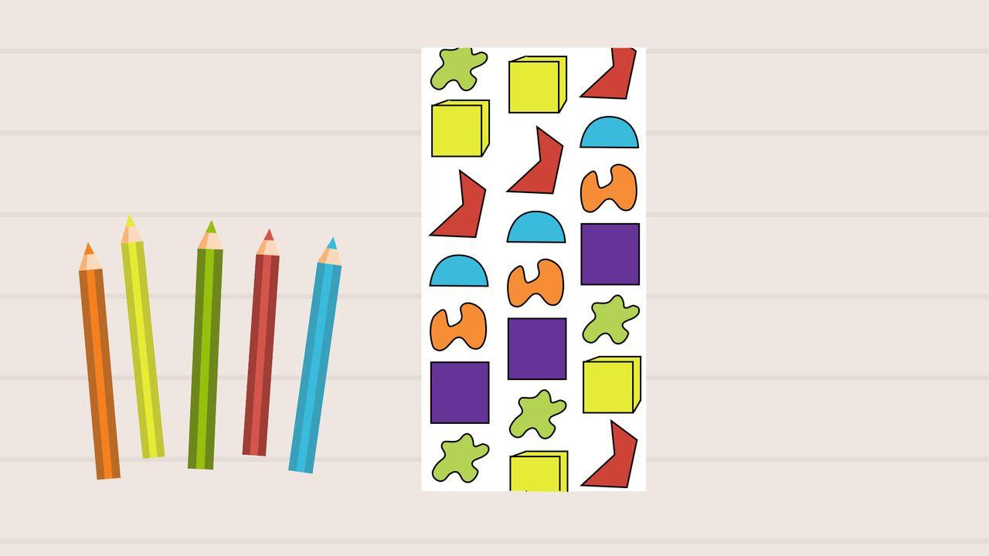
Shape : 02.01 Shape
Page 19
Step Three
After outlining each of your shapes using a thin, black marker, add color to your shapes using colored pencils. Use 3–5 different colors of colored pencils to do this.
Two of those colors will need to be colors that you used to complete your art in Part A and Part B Studio Time. One color you use to color in this pattern should be from Part A Studio Time, and the other color in this pattern should be one that you used in Part B Studio Time.
You will need
a 3x6 piece of white paper, either card stock or drawing paper
a pencil
a ruler
a thin, black marker
colored pencils
optional material—a circle shape to trace
Step Four
Keep your pattern somewhere safe. You will be adding to it later.

Slide 11
Shape : 02.01 Shape
Page 21
Step One
First, use scissors to cut two 1x6 strips out of a piece of white drawing paper. 1x6 means one inch tall by six inches wide.
Step Two
On a flat surface, place a 9x12 piece of black construction paper and all three of your completed pattern artworks from Part A, B, and C Studio Time in front of you.
Practice arranging your three artworks, or panels, in the center of the black construction paper.
Each panel should be one inch apart.
The one inch space between each panel is where you will paste your white strips in a later step.
You will need
your three completed pattern artworks from Part A, B, and C Studio Times
a piece of white drawing paper
an eraser
a pencil
coloring tools of your choice
a thin black marker
9x12 piece of black construction paper
scissors

Slide 12
Shape : 02.01 Shape
Page 21
Step Three
Once you've found the perfect arrangement, paste your first panel from Part A Studio time onto the black construction paper.
Paste one of the white, 1x6 strips beside your first panel.
Step Four
Paste your second panel from your Part B Studio time along the edge of the white 1x6 strip you pasted in step three.
Then, just like step three, paste another of the white, 1x6 strips beside your second panel.
You will need
your three completed pattern artworks from Part A, B, and C Studio Times
a piece of white drawing paper
an eraser
a pencil
coloring tools of your choice
a thin black marker
9x12 piece of black construction paper
scissors

Slide 13
Shape : 02.01 Shape
Page 21
Step Five
Along the edge of the second 1x6 strip you pasted in step four, paste your third panel from Part C Studio Time.
You should now have all of your artworks pasted onto a piece of black construction paper, each separated by one inch strips of white paper.
Step Six
Examine your artwork closely. What else can you add to your artwork to create unity between each of your panels?
On each of the two white strips, use coloring tools of your choice to add shapes and lines that will help unify your artwork.
Consider how these added designs will help to connect each of your patterns together.
You will need
your three completed pattern artworks from Part A, B, and C Studio Times
a piece of white drawing paper
an eraser
a pencil
coloring tools of your choice
a thin black marker
9x12 piece of black construction paper
scissors

Slide 14
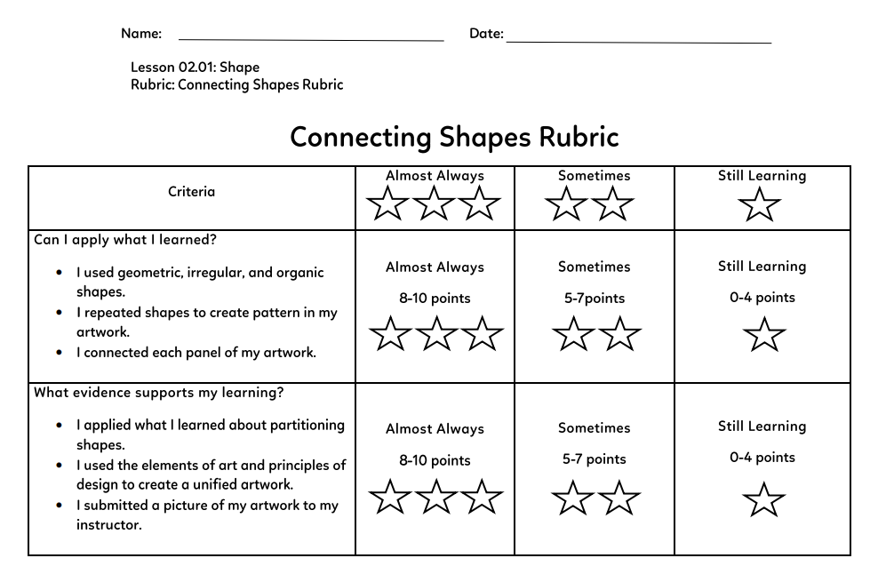
Shape : 02.01 Shape
Page 21
Step Seven
Constructively critique your work. What changes could you make to achieve unity? Sign and date your artwork. Attach your artwork into your sketchbook and keep it safe for later.
Submit your work to 02.01 Shape.
You will need
your three completed pattern artworks from Part A, B, and C Studio Times
a piece of white drawing paper
an eraser
a pencil
coloring tools of your choice
a thin black marker
9x12 piece of black construction paper
scissors

Slide 15
02.02 Bridget Riley

Slide 16
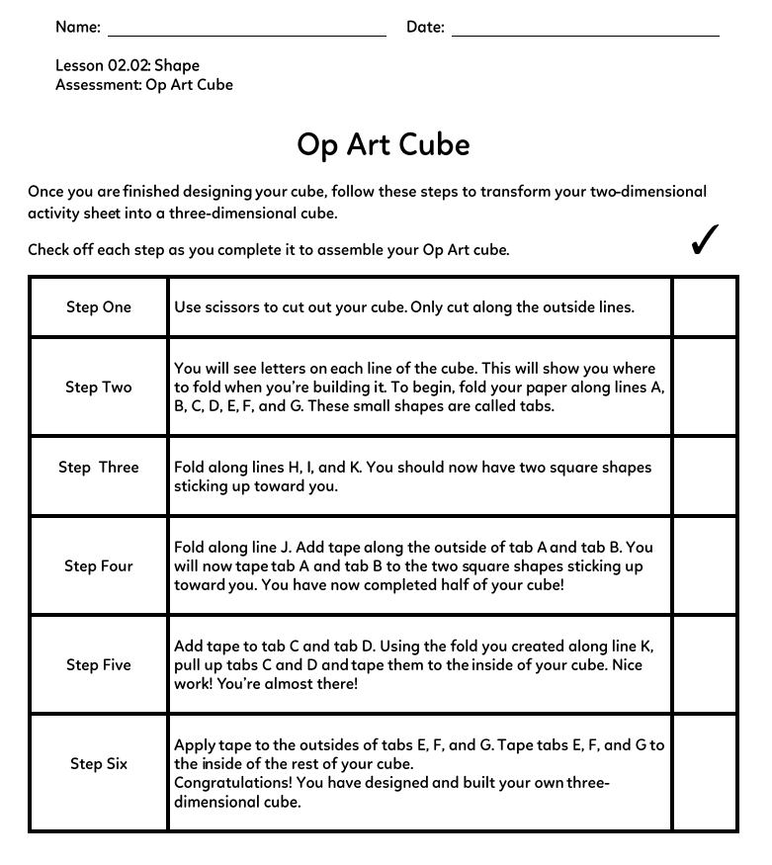
02.02 Bridget Riley
Page 06
Step One
Print the Op Art Cube activity sheet onto white printer paper.
Do Not put the cube together until the assignments says so on page 19.
You will need
Op Art Cube activity sheet
a pencil
an eraser
a thin black permanent marker

Slide 17
02.02 Bridget Riley
Page 06
Step Two
Choose two squares of the cube on the Op Art Cube activity sheet. Using a pencil, fill in these two squares with one or both of the techniques you practiced in the Try It activity.
Step Three
You can choose to outline or color in your Op Art inspired designs using a thin, black permanent marker.
Step Four
Keep your Op Art Cube activity sheet somewhere safe. You will be using it again later.
You have reached the end of Part A!
You will need
Op Art Cube activity sheet
a pencil
an eraser
a thin black permanent marker

Slide 18
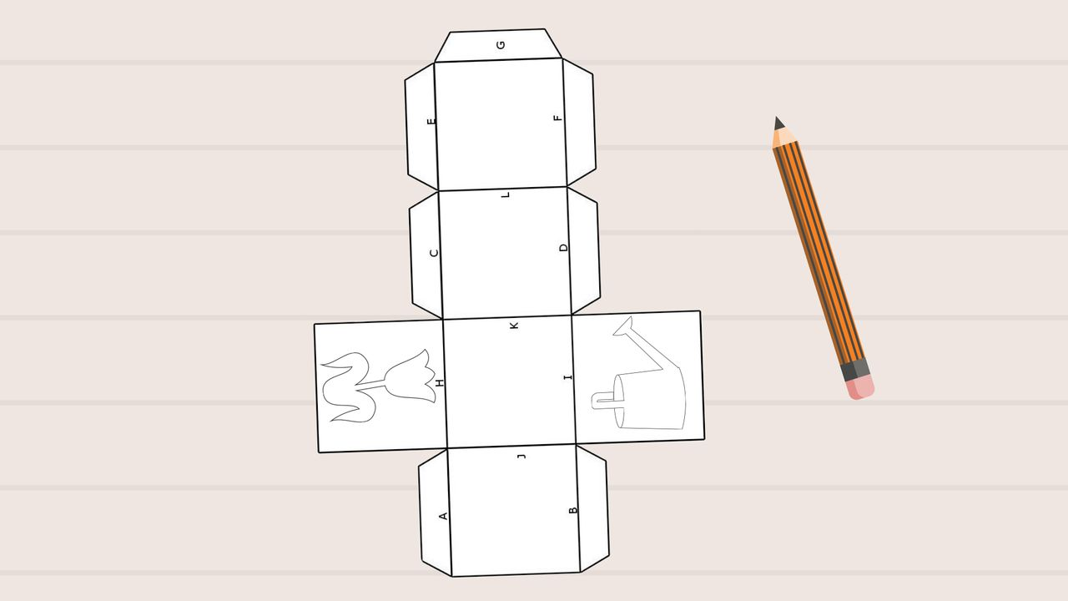
02.02 Bridget Riley
Page 11
Step One
Begin by choosing two blank squares on the Op Art Cube activity sheet that you want to fill in.
Step Two
On each of your two chosen squares, draw the outline of an object using a pencil. Your object can be a vase, a plate, or maybe even a t-shirt.
You will need
your Op Art Cube activity sheet
a pencil
a thin black marker
an eraser
four colorful markers

Slide 19
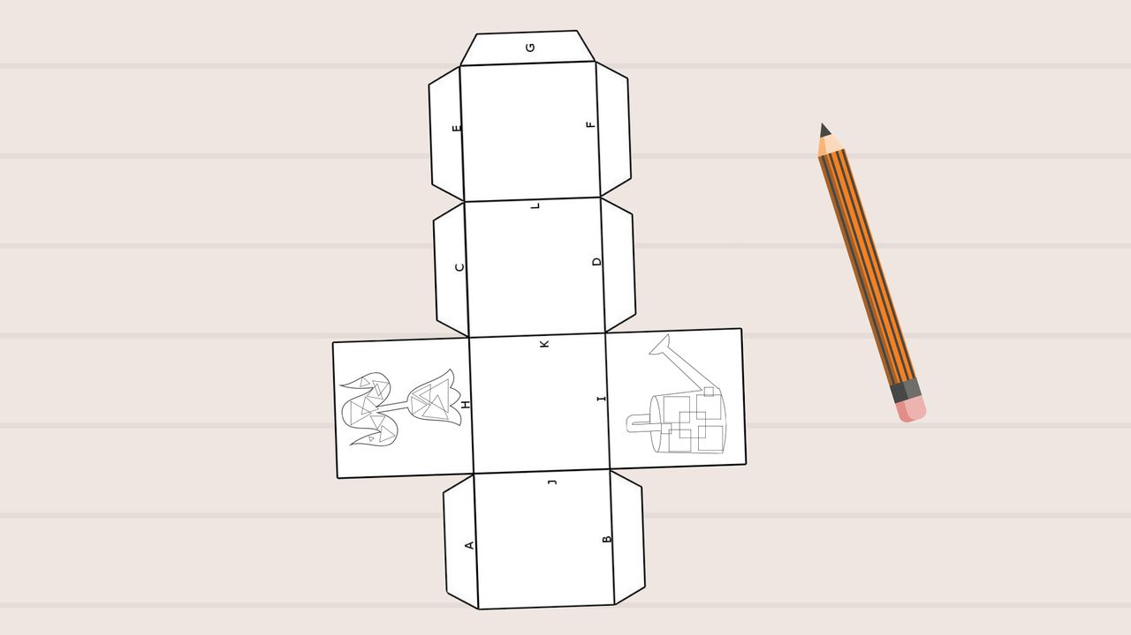
02.02 Bridget Riley
Page 11
Step Three
Choose a geometric shape, like a circle or square. Inside each of your objects, use a pencil to draw the geometric shape. Repeat it so that the shape overlaps within the object.
Be sure to choose different geometric shapes for each of your squares.
You will need
your Op Art Cube activity sheet
a pencil
a thin black marker
an eraser
four colorful markers

Slide 20
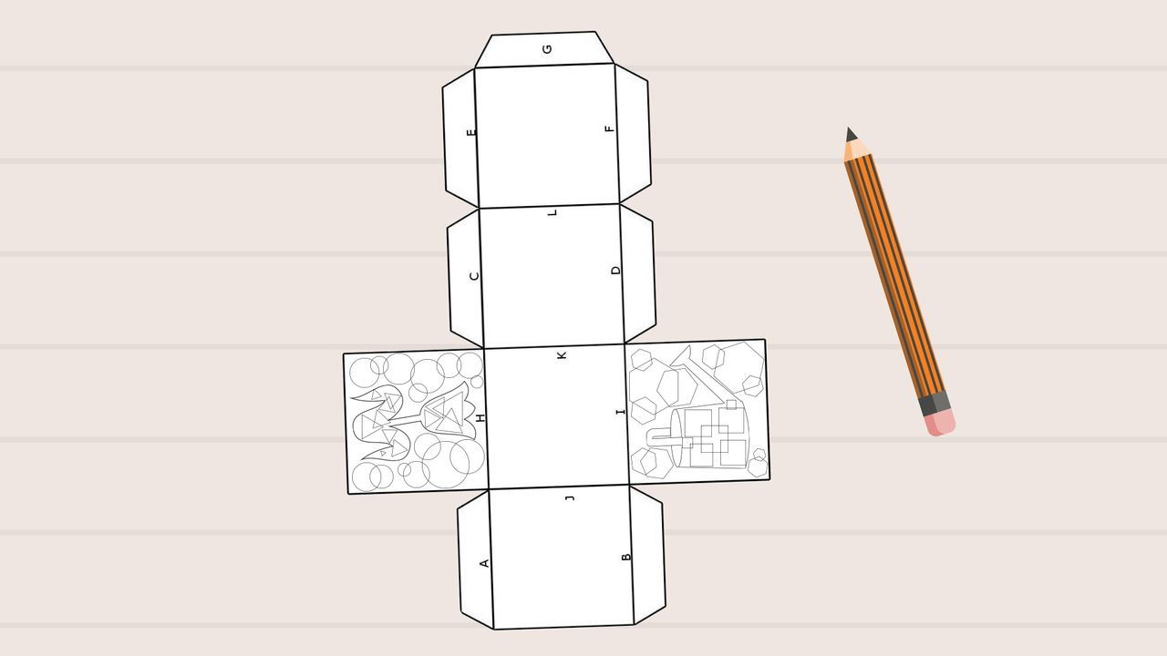
02.02 Bridget Riley
Page 11
Step Four
Now that you've completed the inside of your objects, let's focus your attention to the space surrounding your objects.
Choose a different geometric shape, such as a triangle. In the space around your object, use a pencil to draw the geometric shape. Repeat it so that the shapes overlap.
Be sure to choose different geometric shapes for each of your squares. They should also be different from the shape inside your object.
You will need
your Op Art Cube activity sheet
a pencil
a thin black marker
an eraser
four colorful markers

Slide 21
02.02 Bridget Riley
Page 11
Step Five
Next, use a black marker to trace around the outline of each of your objects. For example, if you've drawn a plate and a t-shirt, only use the black marker to outline the edges of these objects.
Step Six
Now, let's add some color! Color in the shapes you've drawn inside each of your objects. Choose a different color for each object.
The colors you're using to color in your shapes inside each of your objects should be very different so that they stand out!
You will need
your Op Art Cube activity sheet
a pencil
a thin black marker
an eraser
four colorful markers

Slide 22
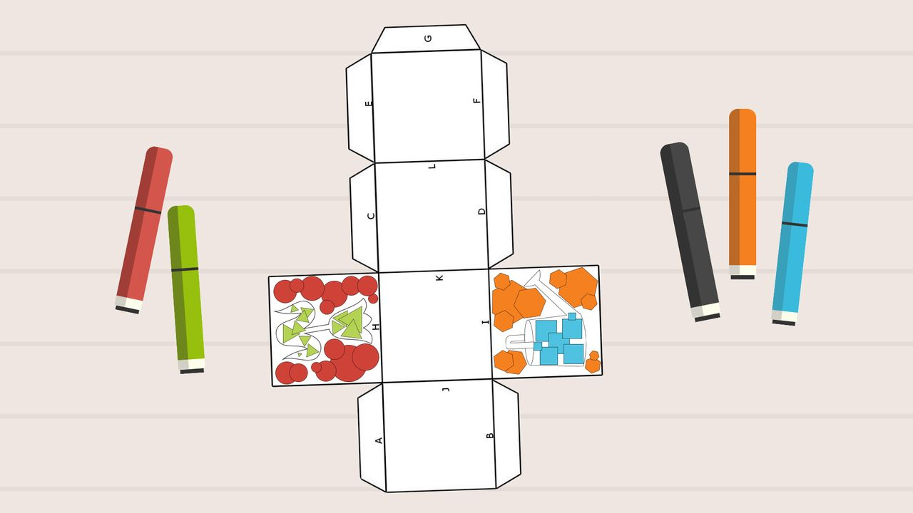
02.02 Bridget Riley
Page 11
Step Seven
Add color to the shapes surrounding your object, too. Similar to Step Six, choose two different colors to use to color in the shapes you've drawn surrounding each of your objects.
Are you using colors that stand out when used together? The more different the colors you're using are, the more your artwork will look like an illusion.
You will need
your Op Art Cube activity sheet
a pencil
a thin black marker
an eraser
four colorful markers

Slide 23
02.02 Bridget Riley
Page 11
Step Eight
Keep your Op Art Cube activity sheet somewhere safe. You will be using it again later.
You have reached the end of Part B!
You will need
your Op Art Cube activity sheet
a pencil
a thin black marker
an eraser
four colorful markers

Slide 24
02.02 Bridget Riley
Page 19
Step One
Look at your Op Art Cube activity sheet for instructions on how to assemble your Op Art Cube.
Step Two
Cut your cube out using scissors to carefully cut along the lines and edges of the Op Art Cube activity sheet. Be sure to not cut off any of the tabs that surround your cube. You will need these to assemble your cube in a later step. As you complete each step on the checklist, check it off! You're one step closer to having your own Op Art Cube.
Step Three
It's time to assemble! Carefully follow the instructions on the Op Art Cube activity sheet to assemble your Op Art Cube. While assembling your Op Art Cube, use clear tape to secure your Op Art Cube together.
You will need
your completed Op Art Cube activity sheet
scissors
clear tape

Slide 25
02.02 Bridget Riley
Page 19
Step Four
In your sketchbook, reflect on two of the optical illusions you created. Think about these questions to guide your reflection.
How did you create your illusions?
What kinds of shapes helped you create them?
What principles of design and elements of art help create unity in your artwork?
Step Five
Take a photograph of your Op Art Cube and attach it to your sketchbook.
Submit your work to 02.02 Bridget Riley.
You will need
your completed Op Art Cube activity sheet
scissors
clear tape

Slide 26
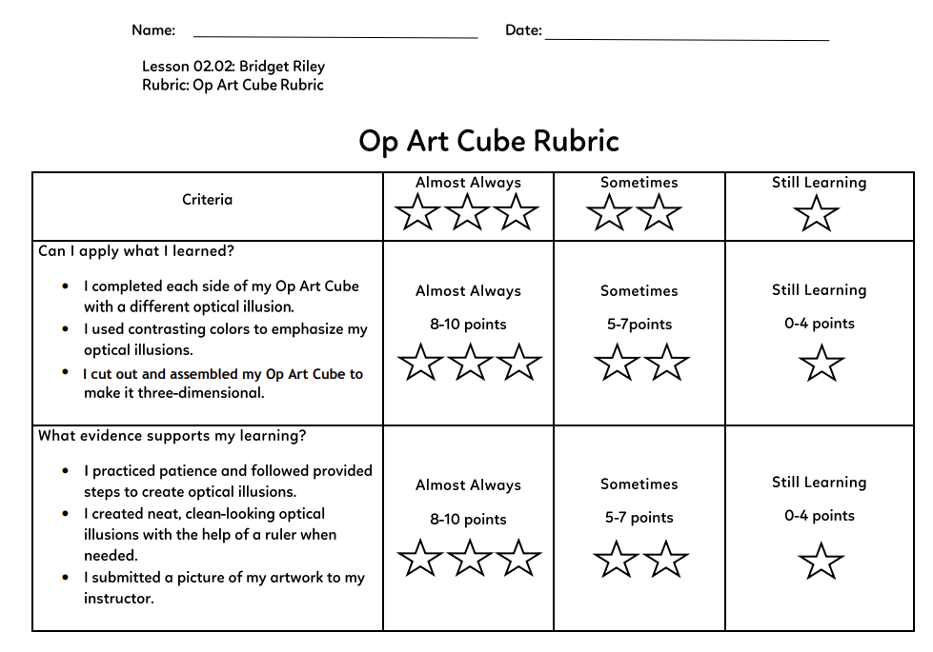
02.02 Bridget Riley
Page 19
Don’t forget to check the Rubric
You will need
your completed Op Art Cube activity sheet
scissors
clear tape

