Slide 1
Unit 1 – Maritime History
Chapter 8 - World War II: The Atlantic War,
1939 - 1945
Section 4 – D-Day and Operation Anvil

Slide 2
Demonstrate an understanding of naval history of World War II: The Atlantic War, 1939 - 1945

Slide 3
Describe the major events of Operation Anvil: Invasion of Southern France
Describe the last few months in Europe before the German forces surrendered

Slide 4

Describe what is meant by the German U-boat wolf-pack tactic.
1.
2.
3.
Note to Instructors:
Click the Show/Hide Response Display Button

Slide 5
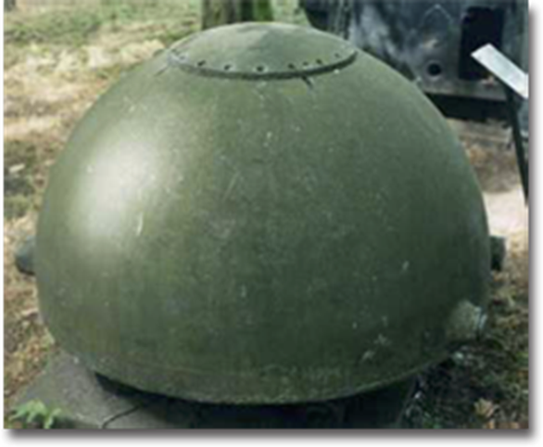
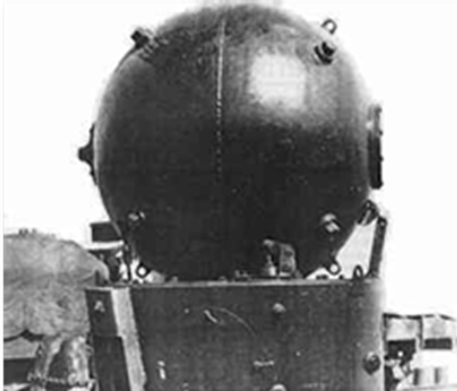
Operation Overlord:
The Invasion of Normandy
Mines were the most deadly German weapon during the Normandy invasion.
The Germans had planted almost every kind of mine in the seas off Normandy.

Slide 6
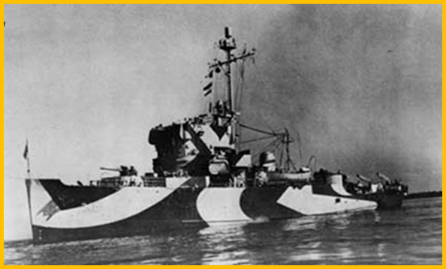
Operation Overlord:
The Invasion of Normandy
Two types of mines:
Contact: Explodes upon impact or contact
Influence: Detonated by magnetic, acoustic or pressure signatures of passing ships
The Allies used nearly 400 minesweepers to try to clear mines before the landings.

Slide 7
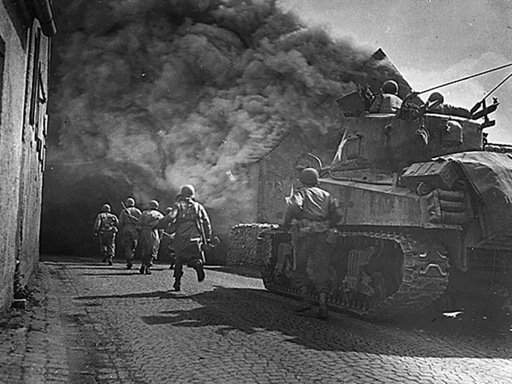
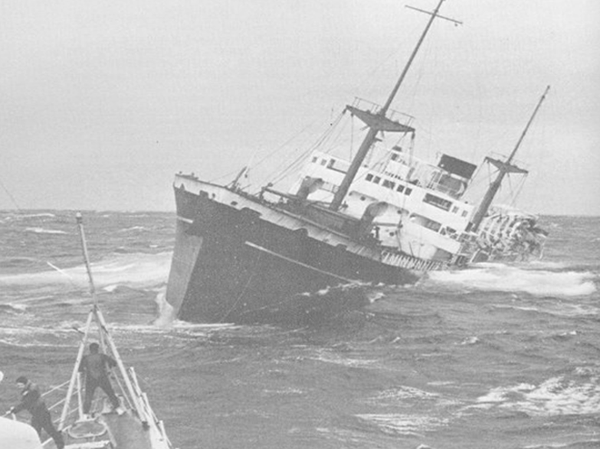
Operation Overlord:
The Invasion of Normandy
Even though minesweepers helped, over 30 Allied ships were sunk by mines during the invasion.
Over the next weeks, more ships were sunk as they ferried supplies across the English Channel.
Despite German resistance, the Allies advanced.

Slide 8
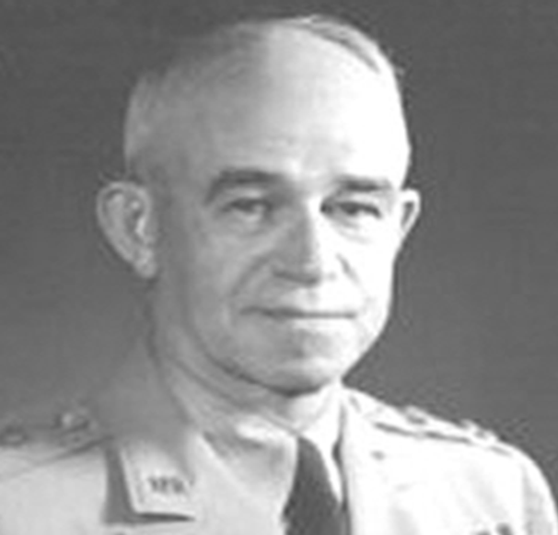
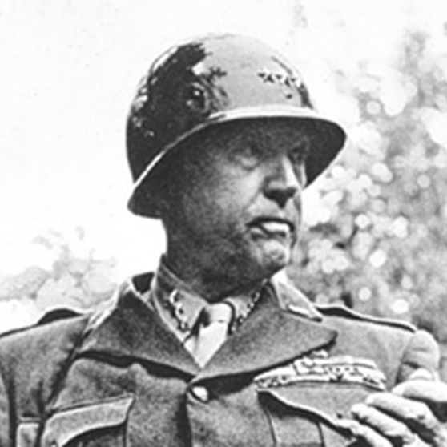
Operation Overlord:
The Invasion of Normandy
General Bradley’s First Army:
Found a weak spot in the German lines
General Patton’s Third Army:
Broke thorough German defenses
Trapped 50,000 German troops

Slide 9
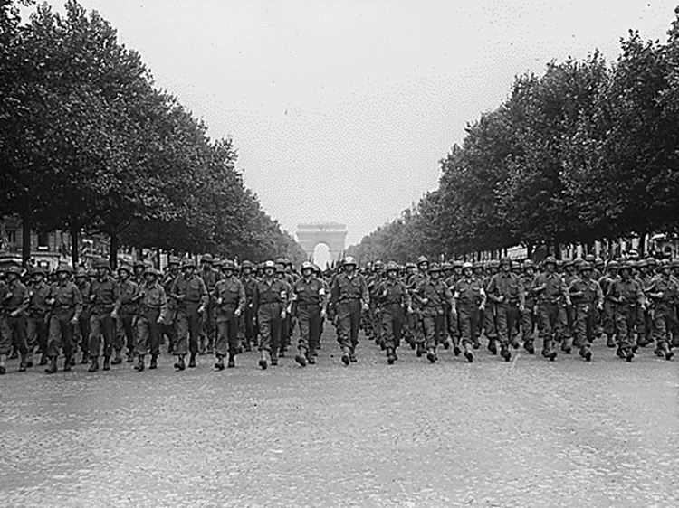
Operation Overlord:
The Invasion of Normandy
On 24 August 1944,
Paris was liberated.

Slide 10
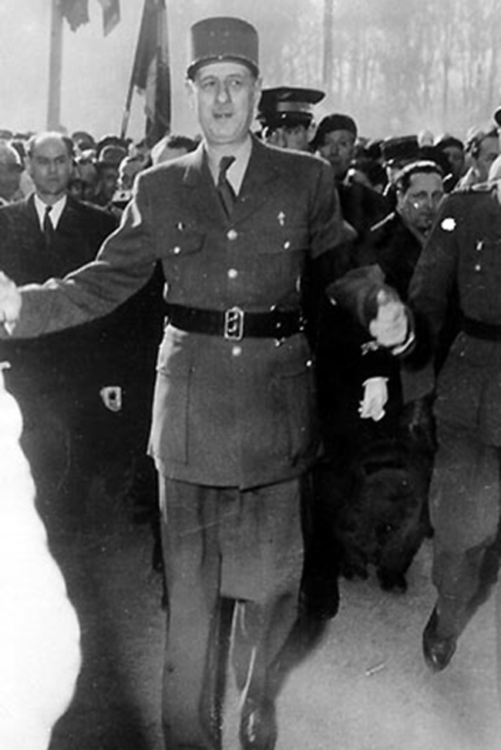
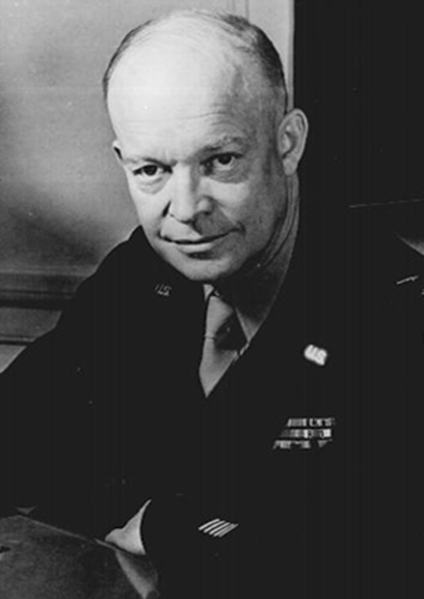
Operation Overlord:
The Invasion of Normandy
General Dwight D. Eisenhower assumed command of all Allied ground troops in Europe.
The Germans were in full retreat.
A new Free French government under General Charles de Gaulle replaced what was left of the Vichy regime.

Slide 11
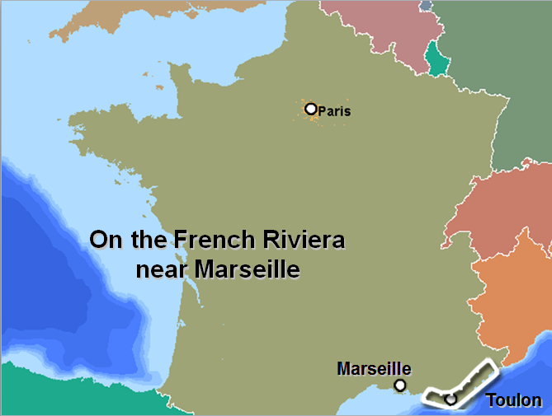
Operation Anvil:
The Invasion of Southern France

Slide 12
Operation Anvil:
The Invasion of Southern France
The two main objectives of this invasion were:
  To gain another port for supplies flowing into France
  To serve as a diversion and draw German forces away from the Normandy beaches

Slide 13
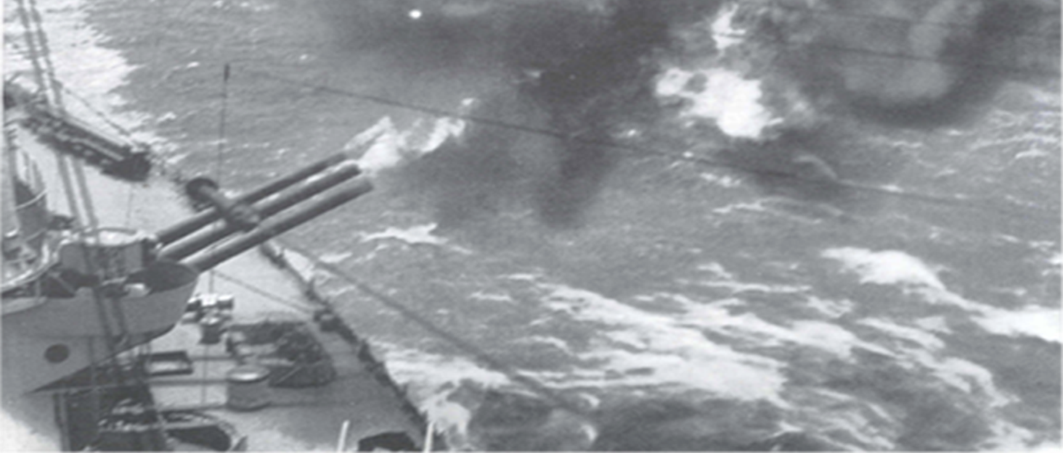
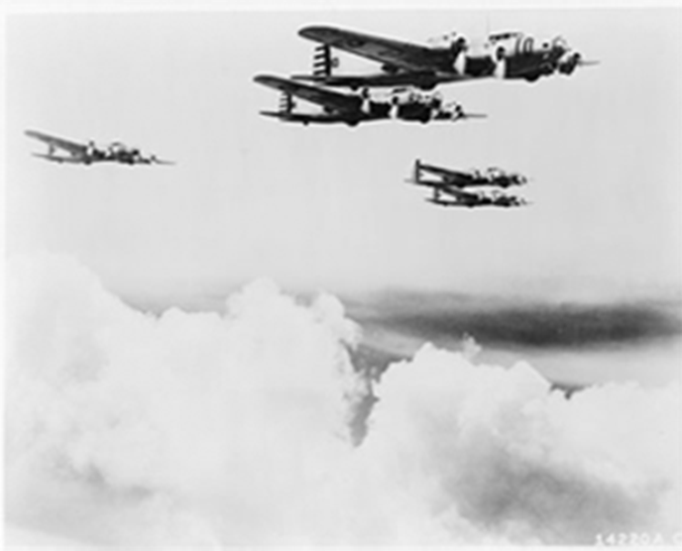
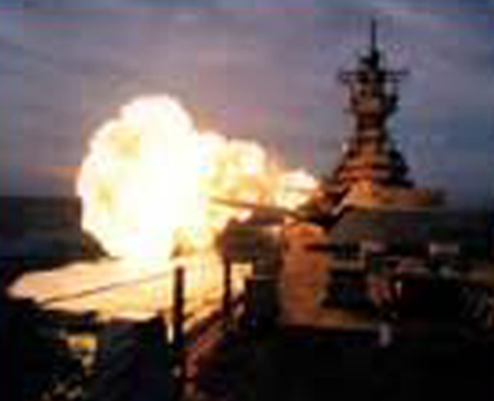
Operation Anvil:
The Invasion of Southern France
The assault was preceded by 1,300 bombers and naval gunfire.
Rockets, naval gunfire and bombing eliminated German resistance allowing the Allies to take the offensive.

Slide 14
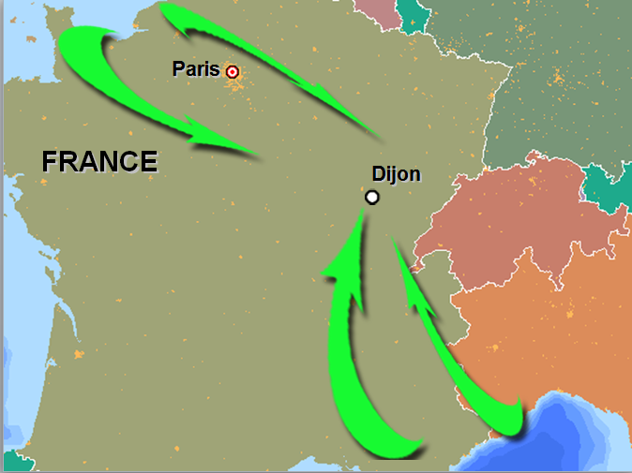
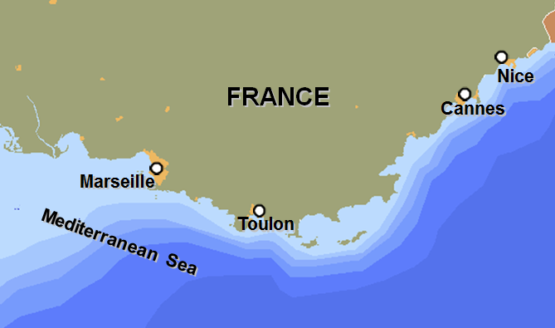
Operation Anvil:
The Invasion of Southern France
By Operation Anvil’s D-Day + 14, the French cities of Marseille, Toulon, Cannes, and Nice fell to the Allies.
Allied forces surged northward and
joined with Patton's forces near Dijon
on 12 September 1944.

Slide 15
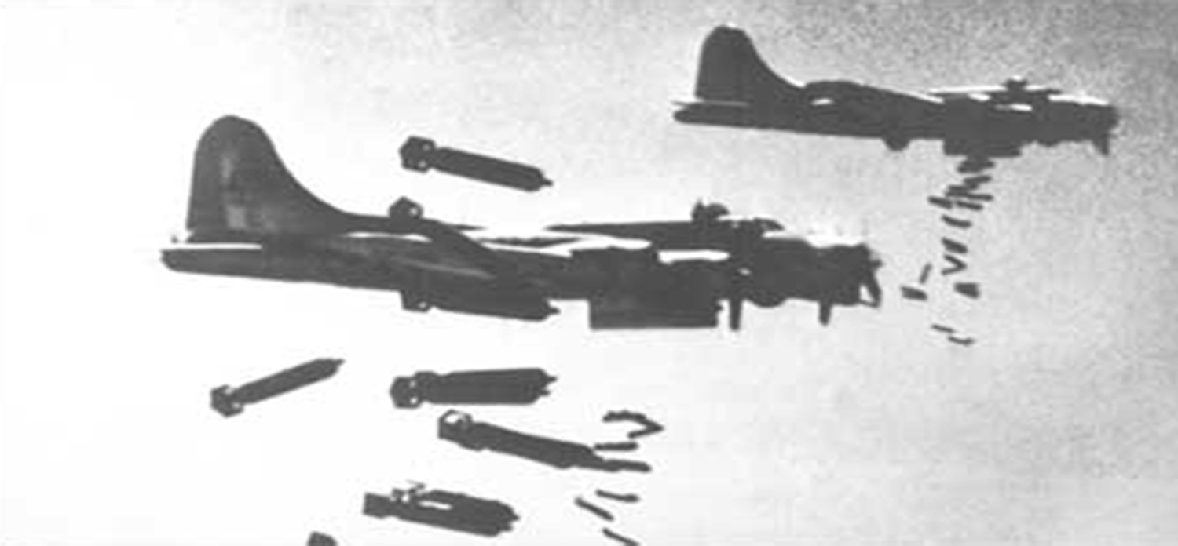
Operation Anvil:
The Invasion of Southern France
Through the summer and fall of 1944, complete control of the air allowed the Allies to move rapidly through France.

Slide 16
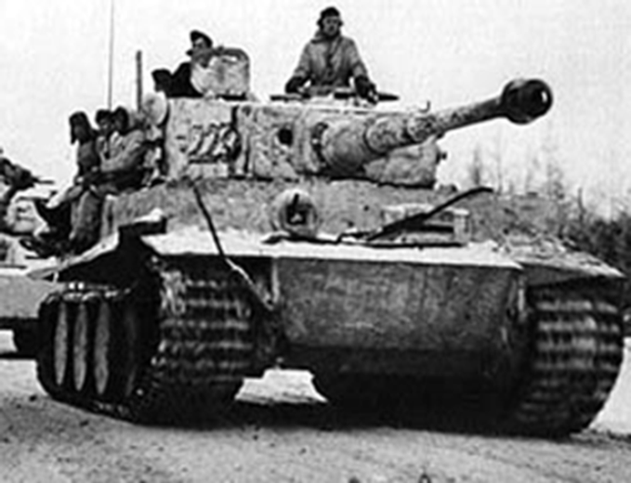
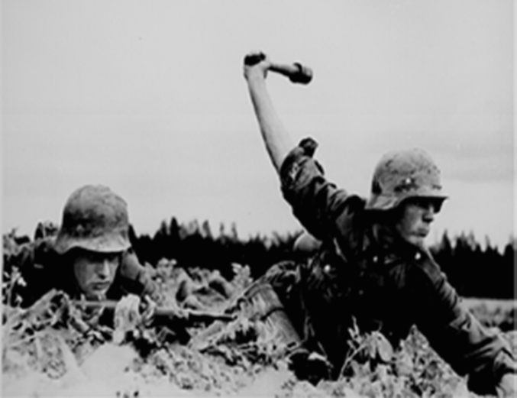
Germany is Defeated
Battle of the Bulge:
Was a major German counteroffensive
Air cover halted by winter weather
Was initiated on 16 December by Field Marshal von Rundstedt who:
  Made quick advances through U.S. lines
  Was stopped by attacks on their flanks

Slide 17
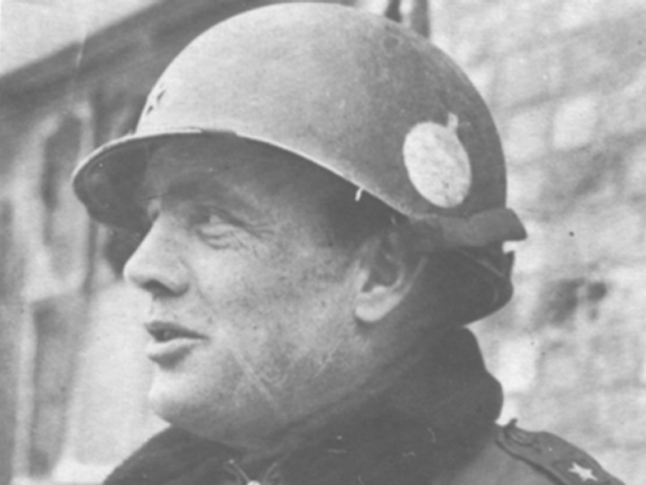
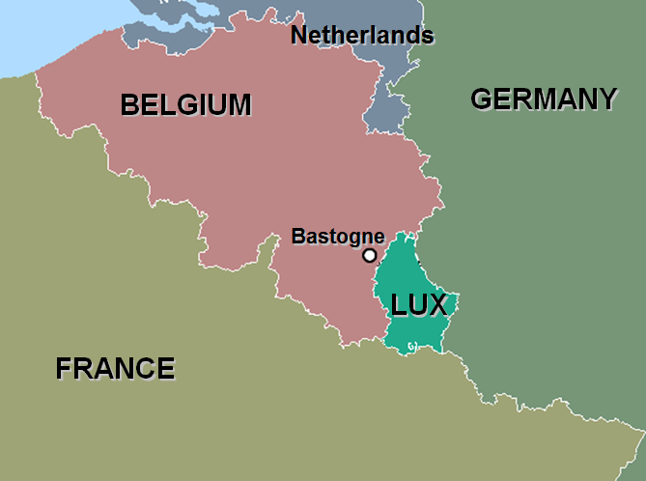
Germany is Defeated
Battle of the Bulge:
Elements of the U.S. 101st Airborne Division had been surrounded by Germans near the town of Bastogne.
In response to a German commander’s
demand to surrender, General McAuliffe
responded eloquently with: “NUTS!”

Slide 18
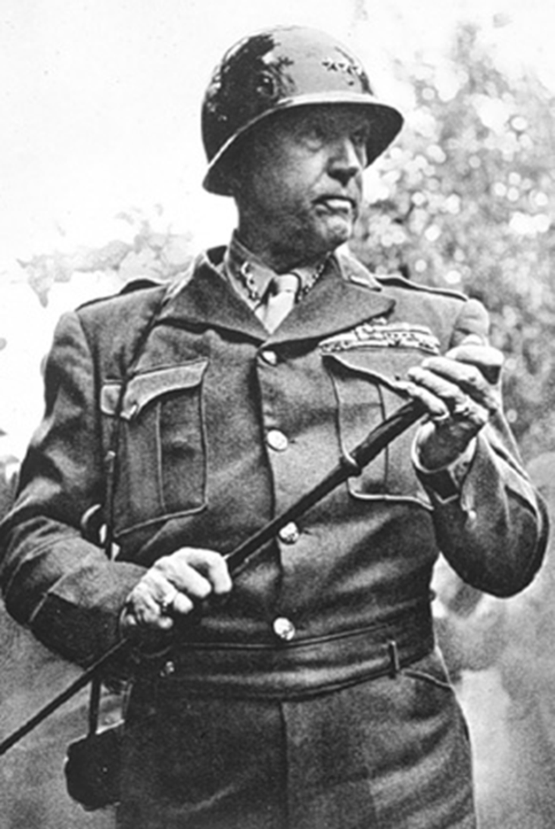
Germany is Defeated
On 27 December 1944,
General Patton’s Third Army broke through the German lines.
The Battle of the Bulge was Germany’s last offensive.

Slide 19
Germany is Defeated
In early 1945, attacks resumed.
Western Front: Americans
Italian Front: British
French
Canadians
Eastern Front: Soviets

Slide 20
Germany is Defeated
Battle of the Bulge:
Was the largest land battle of WW II in which the U.S. participated, including:
  600,000 Germans
  500,000 Americans
  55,000 British
Suffered the following casualties:
  81,000 U.S. with 19,000 killed
  1,400 British with 200 killed
  100,000 Germans killed, wounded or captured

Slide 21
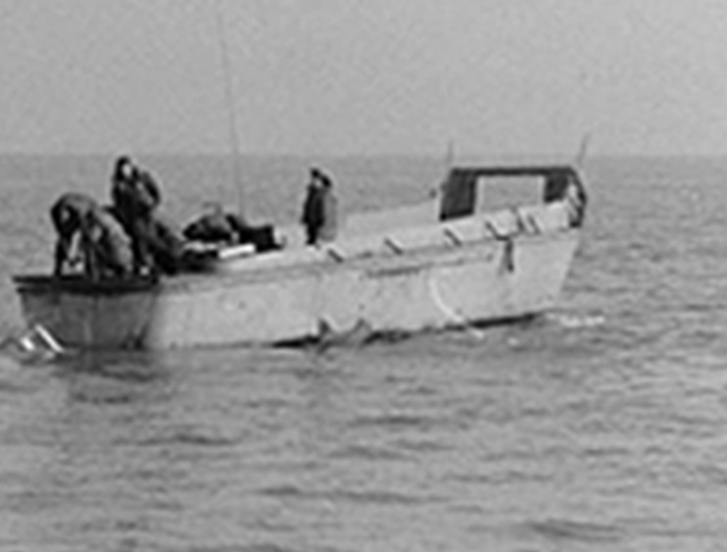
Germany is Defeated
Navy Landing Craft were used extensively to ferry Bradley’s armies over the Rhine River.

Slide 22
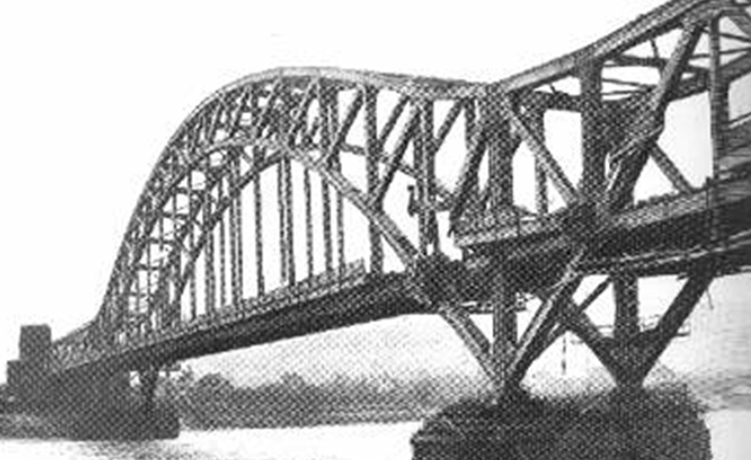
Germany is Defeated
The Ludendorff Bridge in Remagen Germany:
Was wired for demolition but failed
Was captured by the Allies on 7 March
Established major bridgehead across the Rhine River
Withstood 10 days of heavy German artillery fire
Afforded enough time for Allies to cross

Slide 23
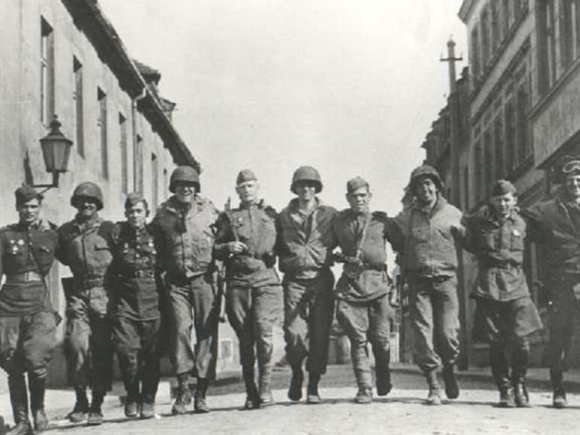
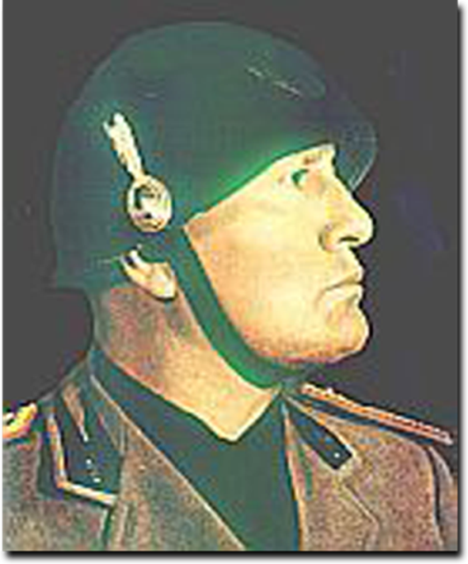
Germany is Defeated
On 25 April 1945, the U.S. and Soviet forces met at the Elbe River.
Three days later, Mussolini was captured and killed by Italian partisans while trying to escape to Switzerland dressed as a German soldier.

Slide 24
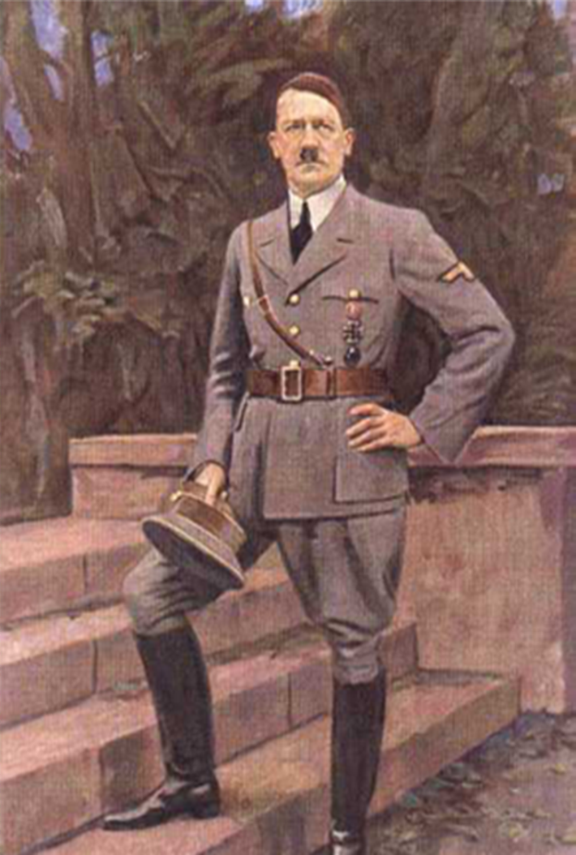
Germany is Defeated
On 30 April 1945, Adolf Hitler named Admiral Dönitz as his successor, then committed suicide in a bunker in Berlin.

Slide 25
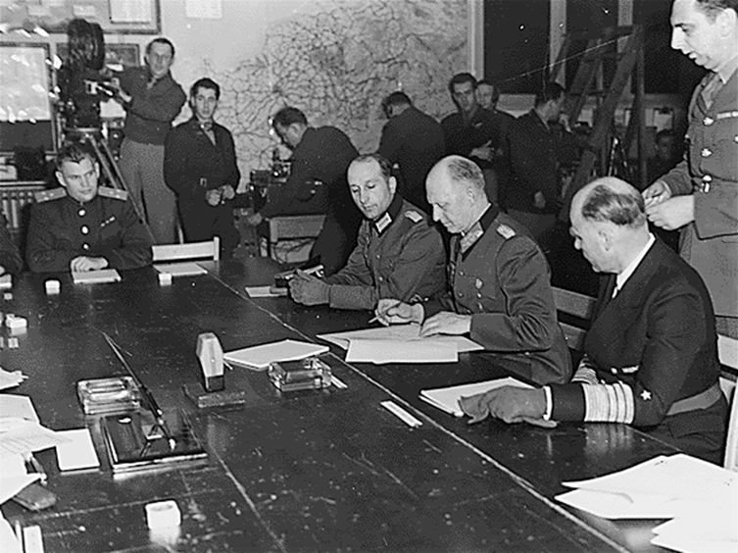
Germany is Defeated
On 7 May 1945, Germany surrendered unconditionally.
Surrender documents were signed at Eisenhower’s headquarters, a little red schoolhouse, in Reims, France.
The war in Europe was over.

Slide 26
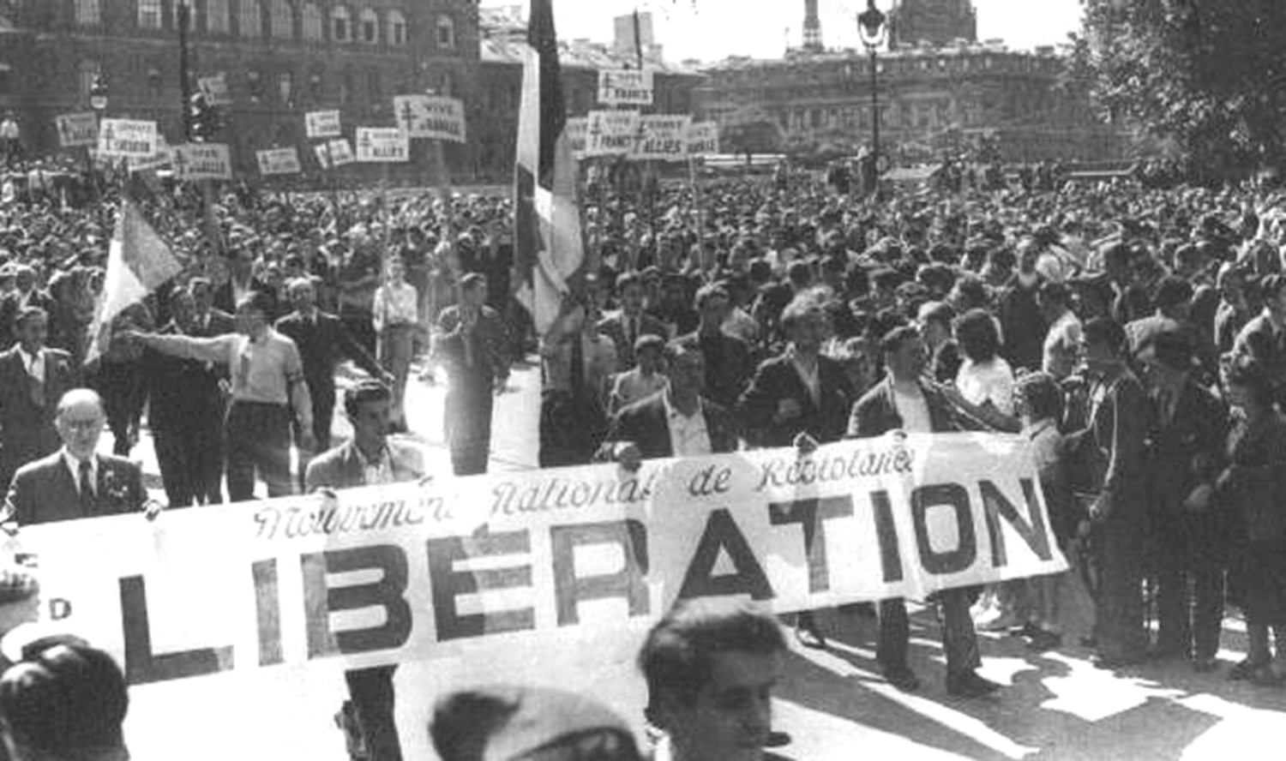
Germany is Defeated
France was quick to celebrate the victory.

Slide 27
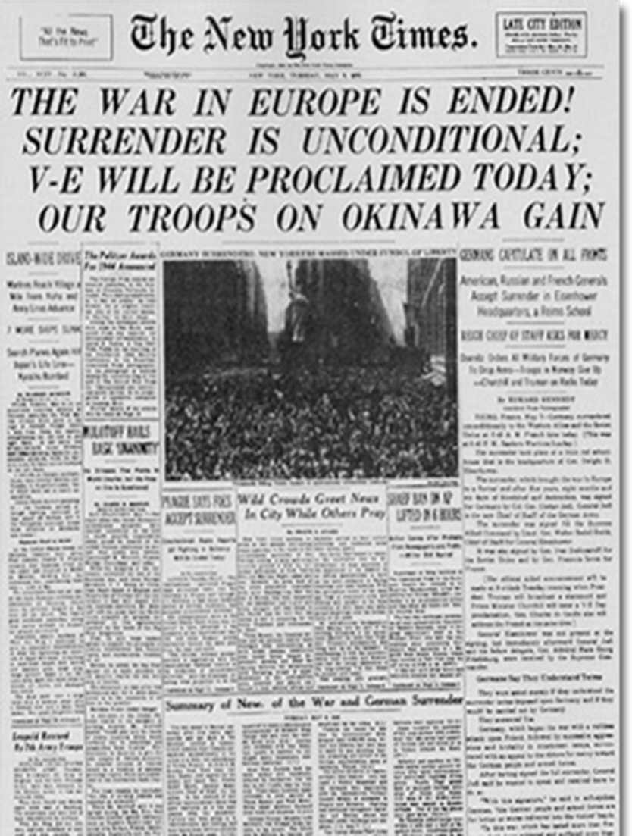
Germany is Defeated
8 May 1945 became known as V-E Day (Victory in Europe).
This was the day the treaty was ratified in Berlin.

Slide 28
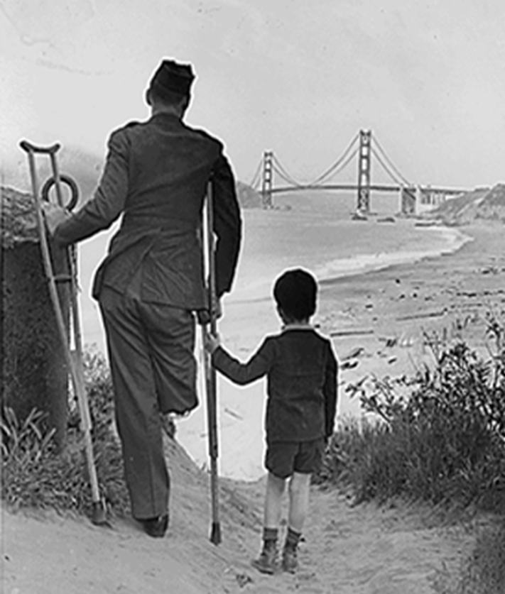
Germany is Defeated
7 May 1945
World War II in Europe was
over.
It had lasted for….
      5 years
      8 months
      6 days
Millions were dead, and there was massive destruction.

Slide 29
Summary Chronology
WORLD WAR II
14 June 1940 | France fell to Germany
7 Dec 1941 | Japan bombed Pearl Harbor
8 Nov 1942 | Allies invaded North Africa
9 Jul 1943 | Sicily attacked
9 Sept 1943 | Italy invaded

Slide 30
Summary Chronology
WORLD WAR II
22 Jan 1944 | Anzio landing
4 June 1944 | U-505 captured
6 June 1944 | D-Day at Normandy
24 Aug 1944 | Allies liberated Paris
16-27 Dec 1944 | Battle of the Bulge
7 May 1945 | World War II ended in Europe

Slide 31
What were the German buzz bombs, and how were they used?
1.
2.
3.
Note to Instructors:
Click the Show/Hide Response Display Button

Slide 32
