Slide 1
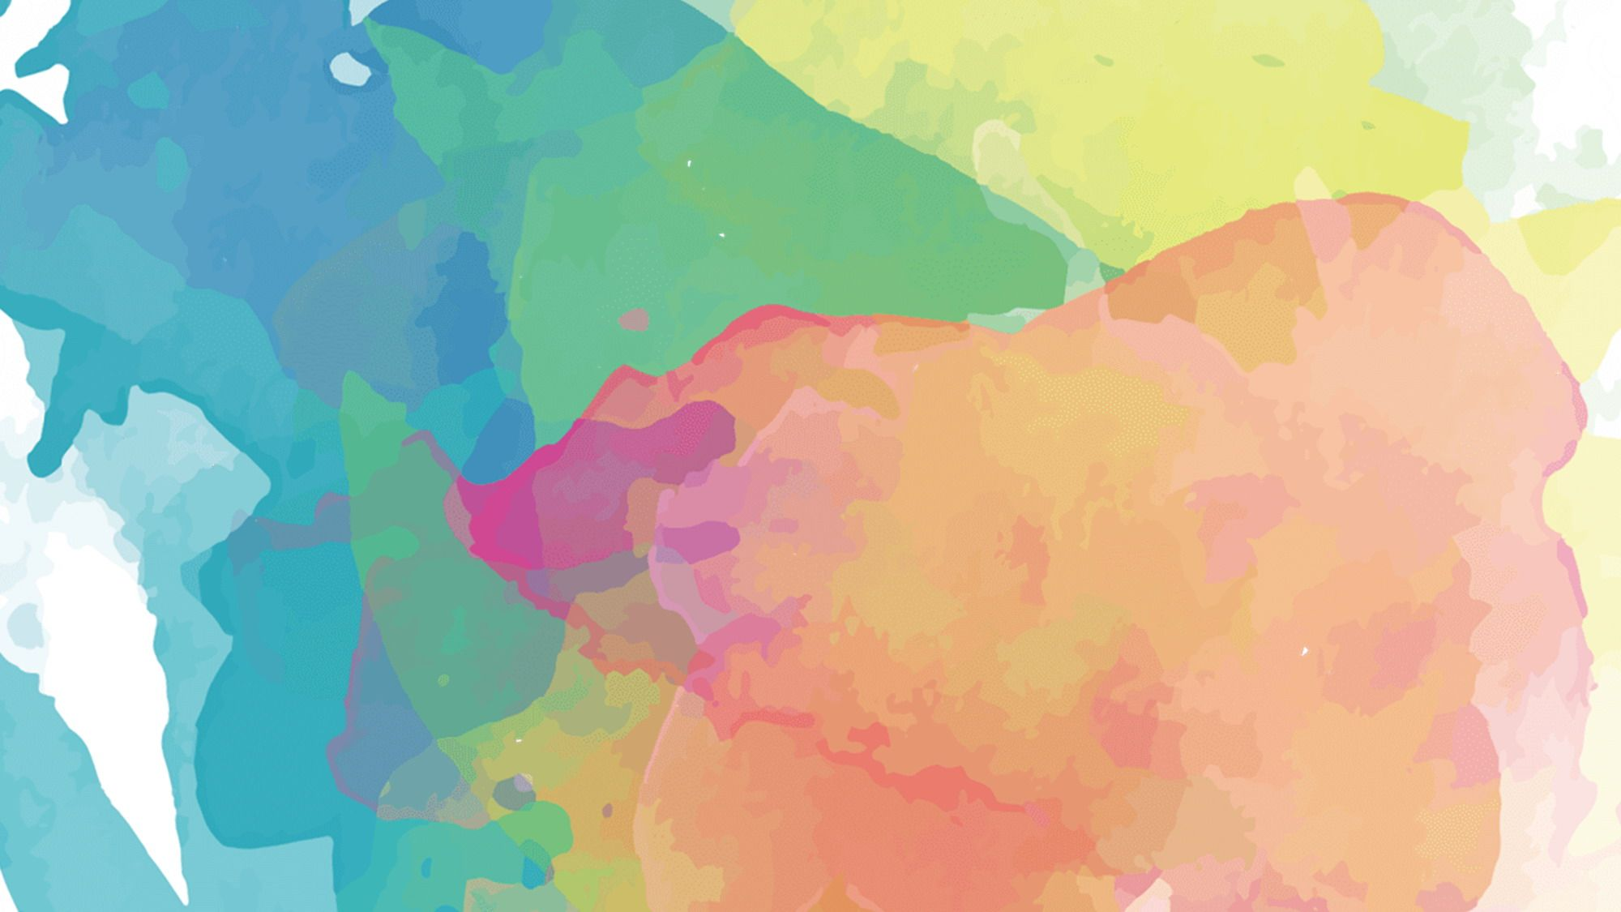



Science Exploration:
Human Impact on the Environment
WATCH
Videos about human impact on the environment
EXPLORE
Pictures of human impact on the environment
READ
About PollutIon and learn ways you can impact the environment
Notes:
Let me know if you have any questions :)
~Brienne
Twitter: @briennepeers
Instagram: @historyinthemitten

Slide 2


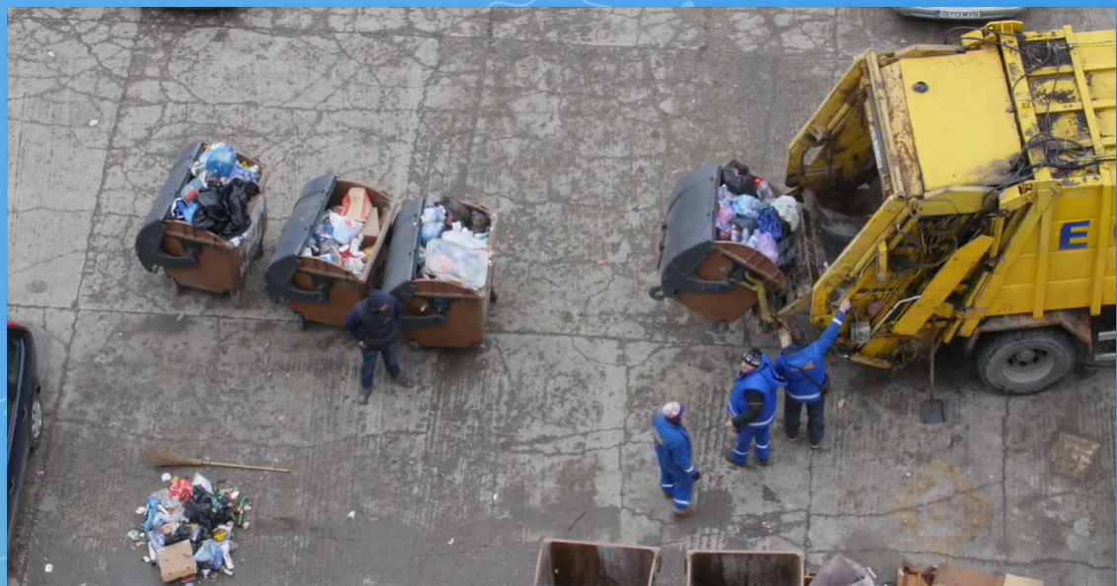
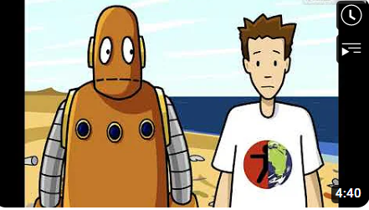
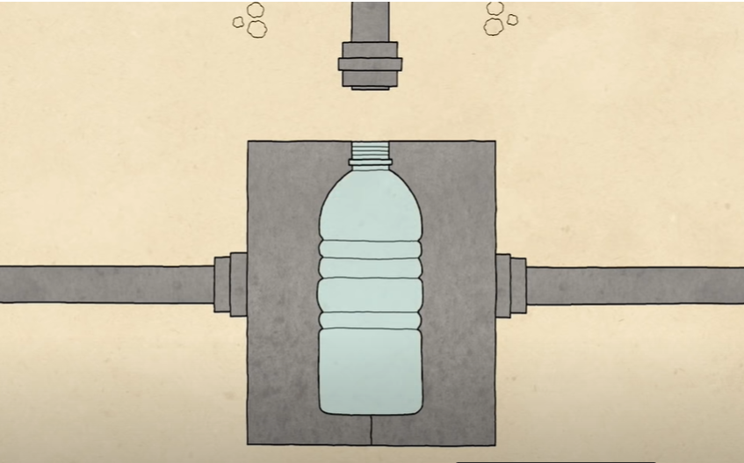
Watch each of the following short videos about Human Impact on the Environment and answer the questions below each video.
Q: What is one example (from the video) of how humans have begun to PROTECT the environment?
A: they have started using things like solar power to reduse energy use
Q: What can you do to help the environment?
A: put things in the right recycling bins
Q: How has plastic manufacturing impacted the environment?
A: It used resources that could not be re-made and things the planet need.

Slide 3


Explore pictures of human impact on the environment by clicking here. Choose two pictures that interest you to observe below.
Picture 1:
3 things I notice about this picture:
1. The large factory
2. The brown water
3. The buildings in the far background
2 things I wonder about this picture:
1. How did the water get so dirty and brown?
2.What is the factory for?
1 thing I learned about human impact on the environment:
1.
Picture 2:
3 things I notice about this picture:
1. The large amounts of trash covering the ground like a thick blanket
2. The seagulls flying around
3. The mountains in the background with no trash on it
2 things I wonder about this picture:
1. How long did it take to get to that much trash
2. Will they keep adding trash to it?
1 thing I learned about human impact on the environment:
1.

Slide 4

Read the National Geographic Encyclopedic Entry about Pollution and answer the questions based on what you read.
Click here to read the entry
What is the definition of pollution?
The introduction of harmful materials into the environment
Name three things that can carry pollutants.
Cars, burning coal, and pesticides.
3. What is one way you (as an 8th grader) can reduce pollution?
Walk instead of asking my parents to drive me places.

