Slide 1
How to Change a Tire
By: Jeffery Willis Keglor

Slide 2
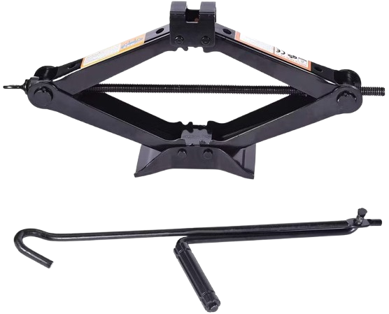
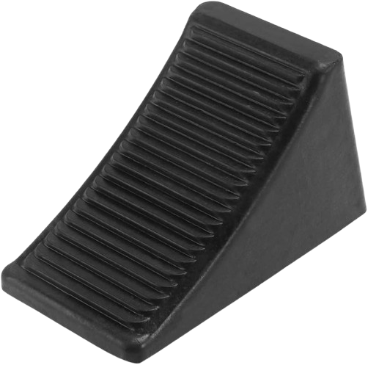
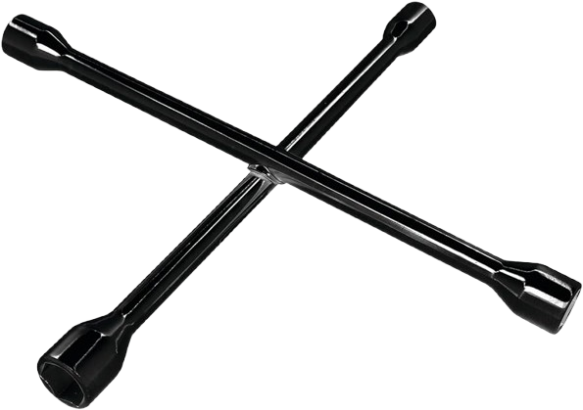
What do I Need?
THESE ITEMS SHOULD HAVE COME WITH YOUR VEHICLE!
Manual car jack
Spare tire
Lug wrench
Wheel wedge
Portable tire inflator
Tire gauge

Slide 3
Title
Where you SHOULD NOT change a flat tire.
Where you SHOULD change a flat tire. Road shoulders recommended.

Slide 4
Title
Loosen the lug nuts:
Remove wheel cover if your vehicle has one.
Use the wrench to turn the lug nuts counterclockwise
Loosen the lug nuts but DO NOT remove them.
Raise the car with the jack, place the jack under the vehicle frame next to the tire that is flat. Raise the car with the jack until the tire has a 6-inch clearance from the ground. Do NOT go underneath the car while you are changing the tire.

Slide 5
Title
Remove the lug nuts and old tire:
Remove them and place them in a safe place
Grab the flat tire with both hands and pul it towards you until it comes off the vehicle, set the tire aside
Attach the spare and replace lug nuts
Line up spare tire with wheel bolts and push into place
Place the lugnuts back and turn them clockwise. Tighten them in a star-like pattern (move to the next nut across) to ensure the wheel mounts evenly. Do NOT fully tighten them until the car is on the ground.

Slide 6
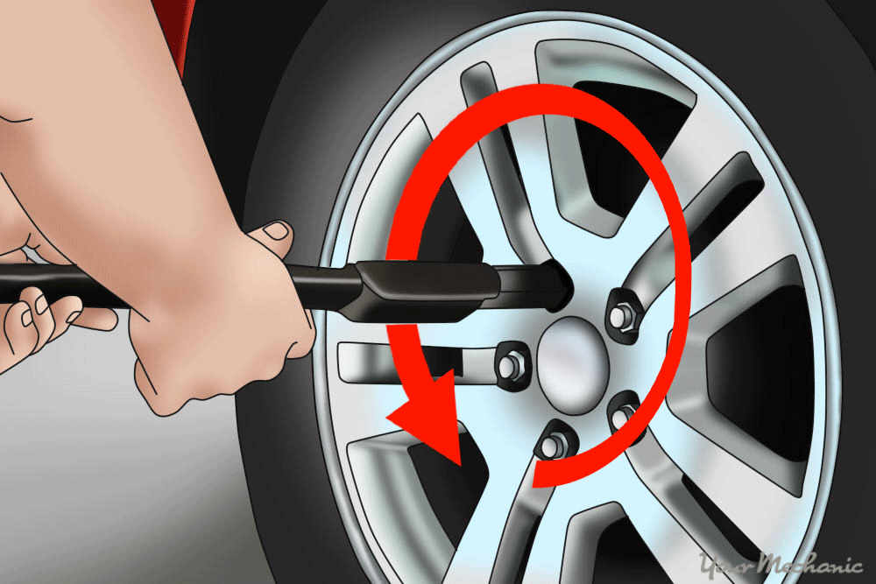
Title
Lower the jack so that the spare tire is on the ground but the car is not completely on the ground.
Put tools back and check the tire pressure using the tire gauge. If you do not have a inflator drive to the nearest gas station, then inflate the tire to the recommended air pressure.

Slide 7
Sources:
“How to Change a Tire.” The Home Depot, 7 Sept. 2023, www.homedepot.com/c/ah/how-to-change-a-tire/9ba683603be9fa5395fab908e21cabb.
How to Change a Flat Tire in 9 Easy Steps | Allstate, July 2024, www.allstate.com/resources/car-insurance/how-to-change-a-flat-tire.

